Slide 1
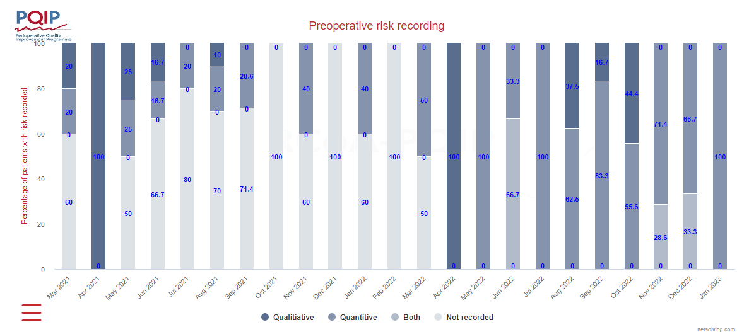
Intervention | Number of patients (% of total)
Consultant Anaesthetist notes review | 188 (52)
Face to face anaesthetist review | 22 (6)
MDT high risk clinic | 36 (10)
CPET | 2 (1)
No intervention | 112 (31)
Total patients | 360
Making Individualised Risk Assessment
‘Business as Usual’ in Preoperative Assessment
A.Gadelkareem and J.Simpson
Colchester Hospital, East Suffolk and North Essex NHS
Foundation Trust
Introduction
Quantitative individualised risk assessment to support clinical decision-making in preoperative assessment should be ‘business as usual’. PQIP recommend this in its reports,¹ due to the Montgomery ruling, which requires the explanation of specific risks to individual patients, as well as to support good practice with shared decision making.
Numerous national guidelines specifically recommend quantitative risk assessment, including the Guidance for Provision of Anaesthesia Services² and the inter-collegiate ‘Preoperative assessment and optimisation for adult surgery guidance’.³ Furthermore the ’Guidance on Establishing and Delivering Enhanced Perioperative Care Services’ recommends that formal risk assessment should form part of the basis of admission criteria for such facilities. Those with a >1% perioperative mortality risk should be considered for admission to enhanced care units.⁴
There are many risk assessment tools available but clinical experience in the UK suggests recent widespread uptake of the ACS NSQIP risk scoring tool⁵ and the Surgical Outcome Risk Tool (SORT).⁶ In this case the SORT was used for screening as it requires relatively few data points (7 variables) of which only one is subjective (ASA grade).
There is a significant national drive to digitalise preassessment services at present with an expectation from the NHS Digital Health and Care Plan (July 2022) that all providers will offer digital pre-assessment to free up capacity in pre-assessment clinics by September 2024.
Figure 3. Pie chart illustrating action done in those patients with SORT >1% .
Table 2 - interventions in preassessment for patients with SORT perioperative mortality >1%
Methods
Quality Improvement methodology was adopted to use PQIP data to support routine use of SORT scoring in the centralised preoperative assessment service at Colchester Hospital, and to improve its use to plan management of higher risk patients in the perioperative pathway.
The first PDSA cycle (Figure 1) was triggered by a recognition from PQIP data at the end of 2021 that rates of individualised risk assessment were low (Figure 2). Therefore, whilst digitalising the preoperative assessment service in 2021/2 there was the opportunity to build the SORT calculator into the preassessment software (Synopsis^{IQ}). The ‘Do’ part of PDSA involved education of the preassessment nurses in the use of Synopsis including completion of the required fields to generate a SORT score and subsequent ‘go-live’ of ‘Synopsis’ in March 2022.
Figure 2 - PQIP data for preoperative risk recording at Colchester hospital from March 2021 to January 2023. Digitalisation of preassessment with automated SORT scoring occurred in March 2022 (red arrow).
Conclusion
Our quality improvement project shows that getting risk assessment automated through digitalisation substantially improves the rate of quantitative risk assessment in preoperative assessment. Data entry in preassessment needs improvement through education and communication, teaching for preassessment nurses and spreading the word by presenting these data in the departmental governance meeting.
Further education is required to standardise the interventions for patients with >1% perioperative mortality risk. In line with recent national guidance; those with >1% perioperative mortality should be considered for post-operative enhanced care and therefore by implication should be reviewed by an Anaesthetist.
Results
The PQIP data for risk assessment from March 2021 to January 2023 is shown in Figure 2; these data are from 106 patients enrolled in PQIP and are in the majority colorectal patients with the remainder orthopaedic (9.4%) and vascular (1.9%). The data show a step change improvement in preoperative risk assessment with the introduction of Synopsis in March 2022 (red arrow in Figure 2), from <50% (except April 2021)of patients risk assessed to 100% being risk assessed from April 2022 onwards for PQIP patients.
The subsequent deeper dive look at data from all-comers to preoperative assessment is shown in Table 1. Over 6 months 4289 patients attended preassessment. Of these, 34% did not have a SORT score calculated as insufficient information was input into the preassessment software. Of those who had a SORT performed, 12.7% had a SORT perioperative mortality >1%. Table 2 and Figure 3 show the interventions for these higher risk patients; 52% had a notes review, 16% a clinic review, 1% a CPET and 31% no anaesthetist review.
Using the PQIP data from prior to and after Synopsis ‘go-live’ we have been able to study (the ‘S’ of PDSA) the effects of implementation. Studying the PQIP data has led us ‘Act’ by taking a deeper dive look at the use of SORT in preassessment.
‘Plan’, in the second PDSA loop, involved requesting data from the Synopsis database from the Business informatics department for all patients attending the preoperative assessment clinic over a six month period between May and October 2022. Data were obtained for these patients regarding the SORT score, date of assessment and nursing and anaesthetist free text reviews. The data were analysed (‘Study’) to identify the proportion of patient with no SORT score performed, those with a SORT score <1% and those with a SORT score >1%. For those with a SORT >1%, the review comments were assessed for intervention for these higher risk patients. Interventions included face to face Consultant anaesthetist review, multidisciplinary anaesthetist/ geriatrician review, notes review by Consultant anaesthetist, cardiopulmonary exercise testing or no intervention.
The final part of this PDSA cycle, ‘Act’ is to present these data to the anaesthetic governance meeting and undertake teaching sessions with the nurses in preassessment to improve the use of SORT in Synopsis and to ensure it facilitates appropriate perioperative management of our higher risk patients.
Acknowledgements Emma Williams and Edyta Klata (research nurses) for PQIP data entry, and to Carol Pitchford (Sister in Preassessement ) and her team for quick adoption of SORT in Preoperative Assessment.
References
Edwards K, Singleton G, Vindola-Padros C et al Perioperative Quality Improvement Programme. Report 3, August 2019- July 2021. Available from https://pqip.org.uk/FilesUploaded/PQIP-Annual-Report_2021.pdf [Accessed March 2023]
Beecroft C, Gooneratne M, Owen N et al. Guidelines for provision of anaesthesia services for the perioperative care of elective and urgent care patients, 2023. Available from https://rcoa.ac.uk/gpas/chapter-2 [Accessed March 2023]
El-Boghdadly K, Lockwood S, Crawshaw A et al. Preoperative assessment and optimization for adult surgery including consideration of COVID-19 and its implications, June 2021. Avaliable from https://www.cpoc.org.uk/sites/cpoc/files/documents/2021-06/Preoperative%20assessment%20and%20optimisation%20guidance.pdf. [Accessed March 2023]
Bryden D, Selwyn D, Bannon M et al. Guidance on establishing and delivering enhanced perioperative care. Available from https://cpoc.org.uk/guidance-establishing-and-delivering-enhanced-perioperative-care-services. [Accessed March 2023].
American College of Surgeons NSQIP Surgical Risk Calculator. Available from https://riskcalculator.facs.org/RiskCalculator/. [Accessed March 2023]
Protopapa KL, Simpson JC, Smith NC, Moonesinghe SR. Development and validation of the Surgical Outcome Risk Tool (SORT).Br J Surg. 2014 Dec;101(13):1774-83 .
SORT score | Number of patients
No result | 1458
<1% 30 day perioperative mortality | 2471
>1% perioperative mortality | 360
Total patients | 4289
Figure 1 – PDSA (Plan Do Study Act) cycle
Table 1 – Analysis of all-comers through preoperative assessment from May 2022 to October 2022, to show how many had a SORT score calculated, and of those who did, how many had a 30 day perioperative mortality of >1%

